Slide 1

CRIMINAL RECORD MANAGEMENT SYSTEM

Slide 2
Team Members
Lakshay Jain (2010991607) (Team Leader)
Manish Walia (2010991614)
Meghna Singh (2010991621)
Mohit Kukreja (2010991629)
Nakul Grover (2010991636)
Presented to : Dr Vikas Solanki (Dept of Computer Science and Engineering)

Slide 3
Introduction to the Project
The purpose of making rules and laws is to give a peaceful life to the citizens living in the society. To have a peaceful life we required a well-organized law enforcement system and to achieve this database has a vital role. By maintaining the proper record of criminals and crime committed by them we can assure that whether law enforcement system is working properly or not. By keeping the record with the help of DBMS we can also identify the crime rate. Our project is also based on handling the data of offences done by the accused including the personal details of prisoners, their prison no., their past criminal record, offence name, IPC sections, and details of victim and officer of that particular case.

Slide 4
Main functions of the Criminal Record Database
1) Helping Hand For Record Keepers:-
The database provides a helping hand in convenient maintenance of criminal’s record and helps inspectors in interaction and sharing of information among police departments and district headquarters.
2) Safe Storage For Crucial Data :-
Keeping the records of prisoners for future investigation of a particular case and keeps the record of criminals safe and confidential.
3) Fast and accurate retrieval Of data:-
The Database System searches all the accurate data about the criminal in no time and it helps in increasing the efficiency of the whole prison and reduce manual and redundant record keeping.
4) Confidentiality of the data:-
Helps in building security and monitoring control to ensure only authorized personal have access to the accused details. Hence it ensures Confidentiality of data.

Slide 5
Database requirements analysis
The specific needs of the system analysis are as follows:
1) User friendliness : The use of the database allows the users to access the database in a very convenient and easy way . Hence it ensures user friendliness of the database.
2) Easier Management : Because of the use of database records , older to older records are easy to manage and can be taken care very efficiently.
3) Reduction of risk : By using the database , we ensure that the risk should be minimal.
4) High Level Security : It provides high level of security with different level of authentication.

Slide 6
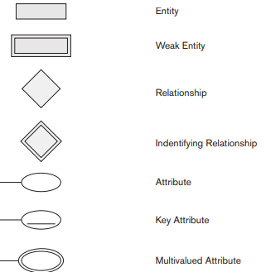
ER Diagram
Symbol Name
Figure 1

Slide 7
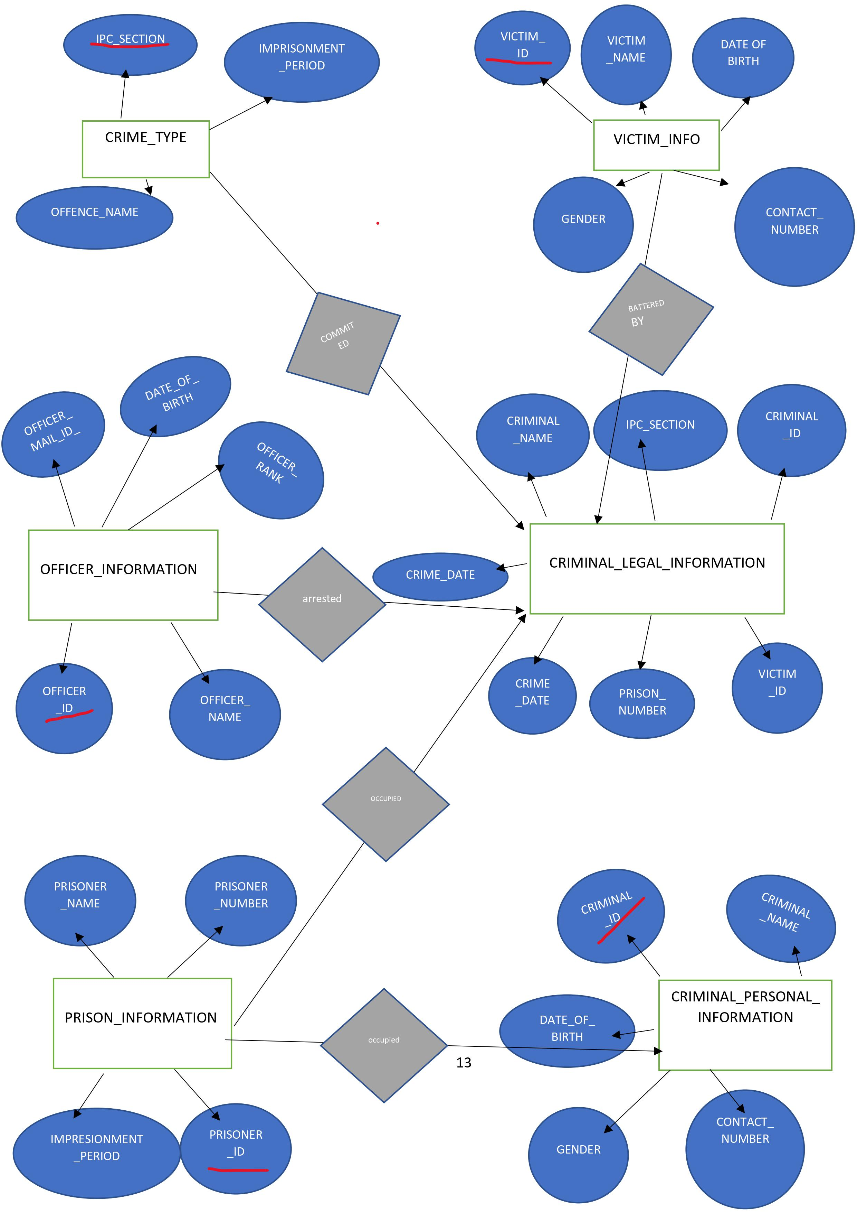
S.NO
Officer_ID
Figure 2
ER Diagram

Slide 8
Normalization of ER Diagram
1) Database normalization is a database schema design technique, by which an existing schema is modified to minimize redundancy and dependency of data.
2) Normalization split a large table into smaller tables and define relationships between them to increase the clarity in organizing data.
3) For making our database on criminal record management system. We can normalize our tables up to 3rd normal form which increase efficiency of this project.
For example: victim_id which is only primary key of victim_information which shows the subset of candidate key and all left attributes are non-prime attributes Hence, similarly all tables are in 2nd Normal form.
In our project there is no transitive dependency Eg. CRIME_TYPE table has relation with CRIMINAL_LEGAL_INFORMATION and CRIMINAL_LEGAL_INFORMATION has relation with VICTIM_INFORMATION table but there is no relation between CRIME_TYPE and VICTIM_INFORMATION table which shows that there is no transitive dependency. Hence, similarly all relations are in 3rd normal form.

Slide 9
Physical Schema
1. Table Name: Victim_Information
Attribute | Type | Size | Constraints
Victim_ID | Int | - | Primary Key
Victim_Name | Varchar | 255 | Not Null
Date_of_birth | Date | - | -
Gender | Varchar | 10 | -
Contact_Number | number | 16 | Not Null

Slide 10
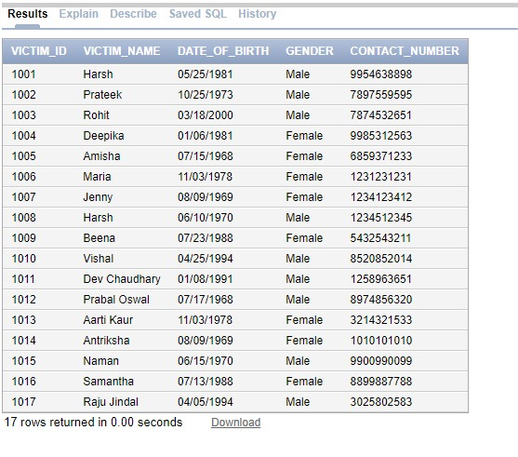
Table 1 : Victim_Information
create table VICTIM_INFORMATION (
Victim_ID int primary key,
Victim_Name varchar (255) not null,
Date_Of_Birth date,
Gender varchar (10),
Contact_Number number (16) not null
);
Output of Table 1

Slide 11
2. Table Name: OFFICER_INFORMATION
Attribute | Type | Size | Constraints
Officer_ID | Int | - | Primary Key
Officer_Name | Varchar | 255 | Not Null
Date_of_Birth | Date | - | -
Officer_Rank | Varchar | 20 | -
Officer_Email_Id | Varchar | 155 | Not Null

Slide 12
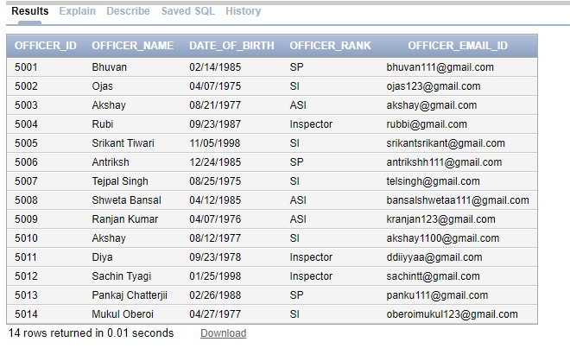
Table 2 :OFFICER_INFORMATION
create table OFFICER_INFORMATION(
Officer_ID int primary key,
Officer_Name varchar (255) not null,
Date_Of_Birth date,
Officer_Rank varchar (20),
Officer_Email_ID varchar (255) not null
);
Output of Table 2

Slide 13
3. Table Name: PRISON_INFORMATION
Attribute | Type | Size | Constraints
Prison_Number | Int | - | Primary Key
Prisoner_ID | Int | - | Foreign Key
Prisoner_Name | Varchar | 255 | Not Null
Imprisonment_Period | Varchar | 255 | Not Null

Slide 14
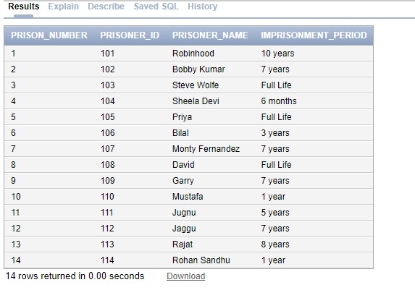
Table 3: PRISON_INFORMATION
create table PRISON_INFORMATION (
Prison_Number int primary key,
Prisoner_ID int CRIMINAL_PERSONAL_INFORMATION(Criminal_ID),
Prisoner_Name varchar (255) not null,
Imprisonment_Period varchar(255) not null
);
Output of Table 3

Slide 15
4. Table Name: CRIMINAL_LEGAL_INFORMATION
Attribute | Type | Size | Constraints
S.No | Int | - | Primary Key
Criminal_ID | Int | - | Foreign Key
Criminal_Name | Varchar | - | Not Null
IPC_Section | Varchar | 255 | Foreign Key
Victim_ID | Int | 20 | Foreign Key
Crime_Date | Date | - | -
Officer_ID | Int | - | Foreign Key
Prison_Number | Int | - | Foreign Key

Slide 16
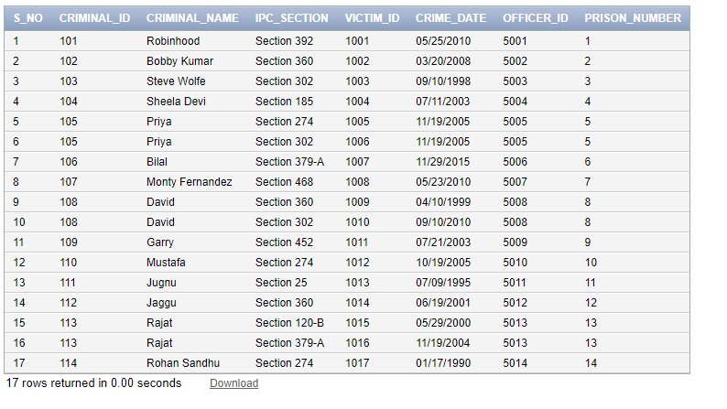
Table 4: CRIMINAL_LEGAL_INFORMATION
create table CRIMINAL_LEGAL_INFORMATION (
S.NO int primary key,
Criminal_ID int references CRIMINAL_PERSONAL_INFORMATION(Criminal_ID),
Criminal_Name varchar (255) not null,
IPC_Section varchar (20) references CRIME_TYPE(IPC_Section),
Victim_ID int references VICTIM_INFORMATION(Victim_ID),
Crime_Date date,
Officer_ID int references OFFICER_INFORMATION(Officer_ID),
Prison_Number int references PRISON_INFORMATION(Prison_Number)
);
Output of Table 4

Slide 17
5. Table Name: CRIME_TYPE
Attribute | Type | Size | Constraints
IPC_Section | Varchar | 20 | Primary Key
Offence_Name | Varchar | 255 | Not Null
Imprisonment_Period | Varchar | 255 | Not Null

Slide 18
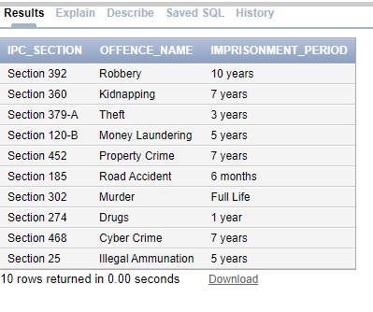
Table 5: CRIME_TYPE
create table CRIME_TYPE (
IPC_Section varchar (20) primary key,
Offence_Name varchar (255) not null,
Imprisonment_Period varchar (255) not null
);
Output of Table 5

Slide 19
6. Table Name: CRIMINAL_PERSONAL_INFORMATION
Attribute | Type | Size | Constraints
Criminal_ID | Int | - | Primary Key
Criminal_Name | Varchar | 255 | Not Null
Date_of_birth | Date | - | -
Gender | Varchar | 10 | -
Contact_Number | number | 16 | Not Null

Slide 20
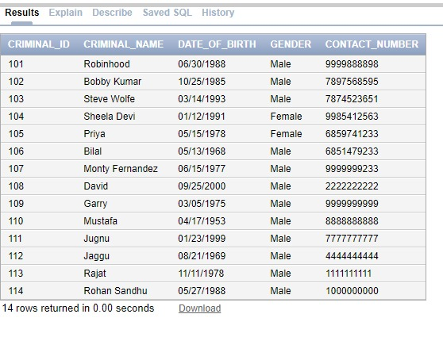
Table 6: CRIMINAL_PERSONAL_INFORMATION
create table CRIMINAL_PERSONAL_INFORMATION (
Criminal_ID int primary key,
Criminal_Name varchar (255) not null,
Date_Of_Birth date,
Gender varchar (10),
Contact_Number number (16) not null
);
Output of Table 6

Slide 21
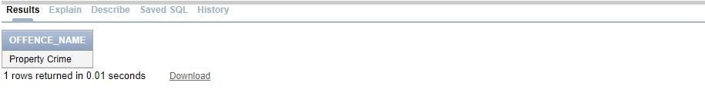
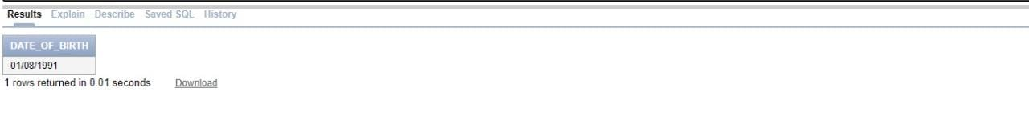
Interactive Queries
Question 1: Write a query to find the offence name of criminal whose name is Garry.
Query 1: select offence_name from crime_type where ipc_section= (select ipc_section from criminal_legal_information where criminal_name='Garry');
Question 2: Write a query to find date of birth of person who is victim of property crime offence.
Query2: select date_of_birth from victim_information where victim_id=(select victim_id from criminal_legal_information where ipc_section=(select ipc_section from crime_type where offence_name='property crime'));

Slide 22
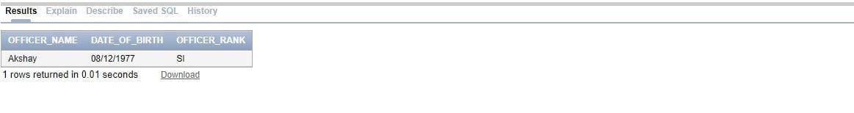
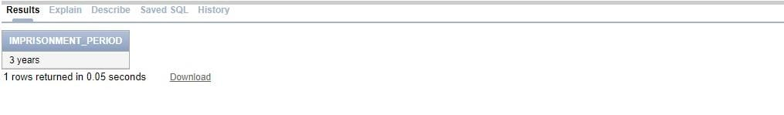
Question 3: Write a query to display officer name, date of birth and rank of officer who is investigating the case of prison number 10.
Query 3: select officer_name,date_of_birth,officer_rank from officer_information where officer_id=(select officer_id from criminal_legal_information where prison_number=10);
Question 4: Write a query to display imprisonment period of criminal who has committed crime on 11/29/2015.
Query 4: select imprisonment_period from crime_type where ipc_section=(select ipc_section from criminal_legal_information where crime_date='11/29/2015');

Slide 23
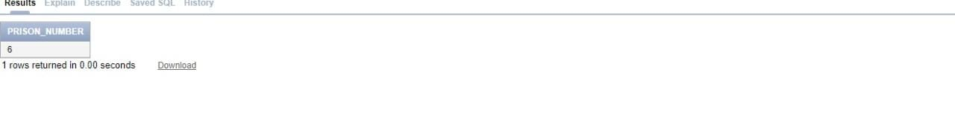
Question 5: Write a query to display prison number of criminal whose contact number is 6851479233.
Query 5: select prison_number from prison_information where prisoner_name= (select criminal_name from criminal_legal_information where criminal_id=(select criminal_id from criminal_personal_information where contact_number=6851479233));

Slide 24
Key Benefits of Criminal Record Management System
1) With the help of database , we can easily search or maintain the record of the criminal.
2) To maintain proper record of criminal details for future investigation . It will provide reports instantly of existing criminal records when needed.
3) Facilitate interaction and sharing of information among police departments , districts , state/headquarters and other police agencies.
4) Ensuring the information accuracy , minimize information passages and to reduce redundancy.
5) Building security and monitoring controls so that only authorized user has the right to access the records, retrieve the necessary information ,add or search the information about the criminals.
6) Criminal background screening helps enterprises comply with regulations, protect their assets and avoid costly negligent hiring claims.
7) To help inspectors in interaction and sharing of information among police departments and district headquarters.

Slide 25
Conclusion
After a lot of investigation , research , analysis , design and developments , the basic management of the criminal record management system is completed. Its function basically meet the demand , to achieve the management of the side and maintain the proper record of the criminals. It is equally important to insert , modify , delete and query the data. From the beginning of the design of the system structure, analysis of how to start, how to design, so we mastered how to distribute the development of application software.

Slide 26
Future Work
There are various scope of improvement of our project. Following points can be improved to optimize it.
This project has different features like police can record criminal details in a database, also view the information about the criminals.
There are several things that can be adapted in future like rapid response team which means we can quickly search about the criminals.
Multilingual support can be provided so that it can be understandable by the person of any language.
Manage & backup versions of documents online.
Searching techniques can be more optimized.
More validation checking can be added.
Security can be extended to high level.

Slide 27
Annexure - A
S.NO | TEAM MEMBER NAME | ROLE PERFORMED
 | Lakshay Jain | Content Researcher and Technical work
2. | Manish Walia | Content Writer and Researcher
3. | Nakul Grover | Researcher and System based work
4. | Mohit Kukreja | Database Creator
5. | Meghna Singh | Content Reviewer

Slide 28

THANK YOU

